Slide 1
Deep Learning – Convolutional Neural Networks (CNN)
By,
Divesh R. Kubal
Data Scientist, eClerx Services
Center of Excellence – Machine Learning

Slide 2
Table of Contents
Image Representation
Sample MNIST Dataset Introduction
Hand Engineering Features from Images
Introduction to Tensors
1D and 2D Convolution Concept Explained
Stacking Layers
Convolutional Layer
Pooling Layer
Activation Layer
Comparison of weights in FC and CNN
Beyond Images
Limitations of CNN
Exercise Problem Statement

Slide 3
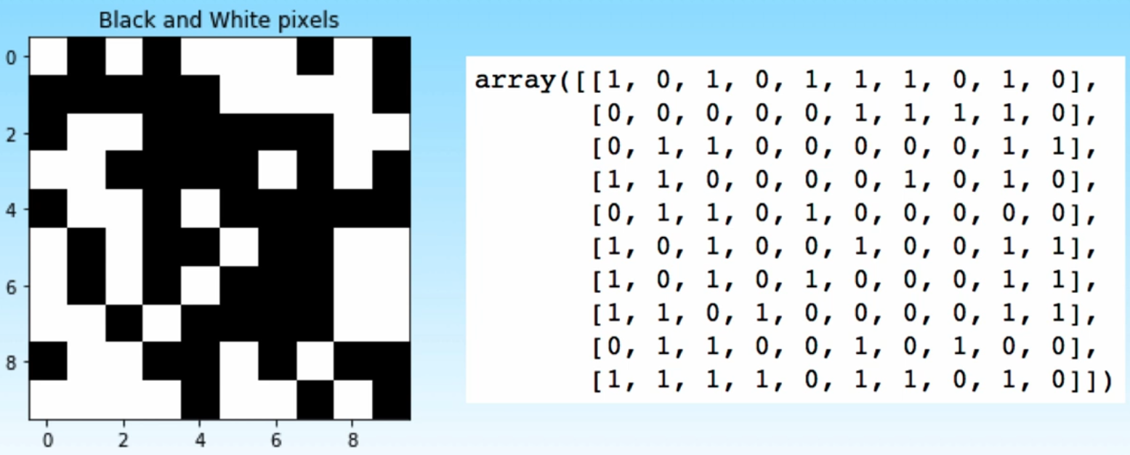
Image Representation

Slide 4
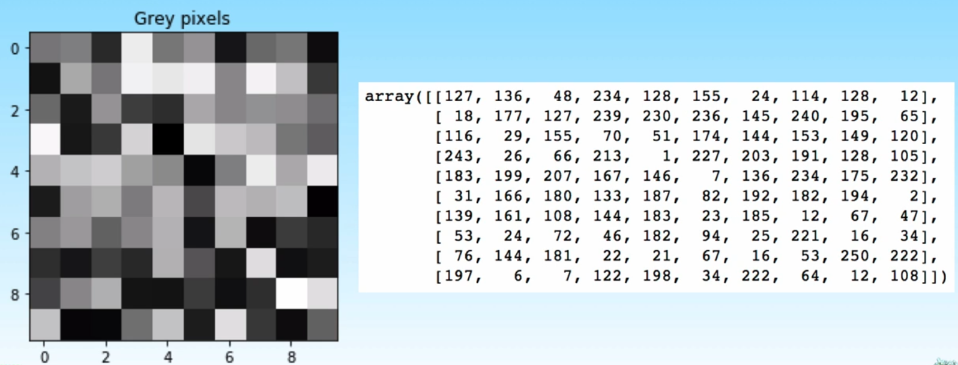
Grayscale

Slide 5
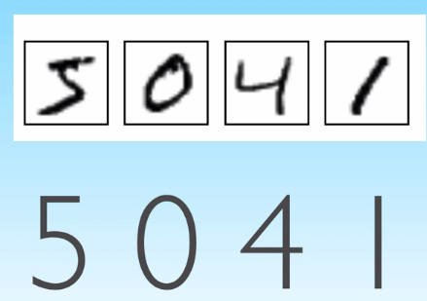
MNIST Dataset

Slide 6
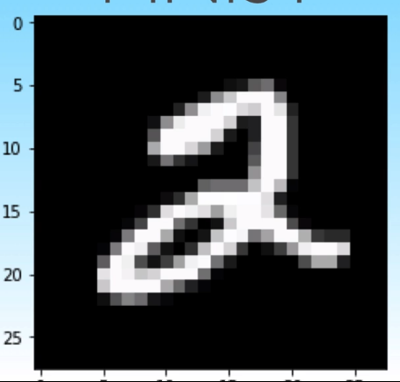
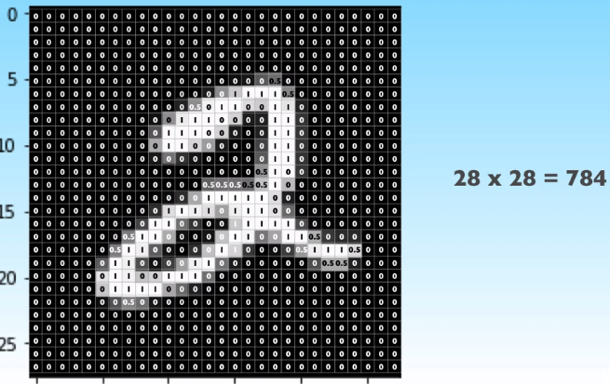
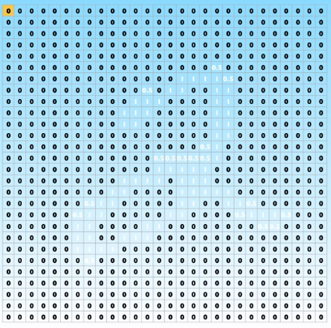
MNIST Sample Image

Slide 7
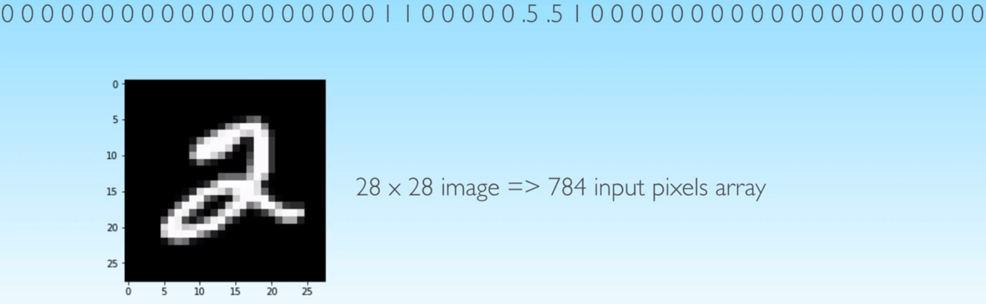
Images unrolled as long vector

Slide 8
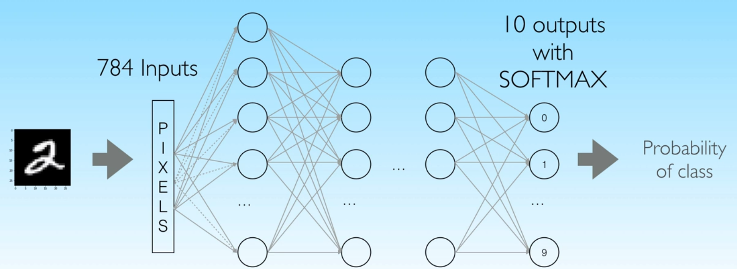
Fully Connected Neural Network Architecture

Slide 9
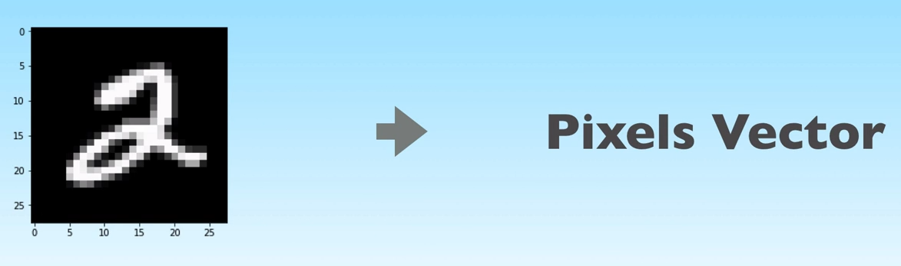
Features

Slide 10
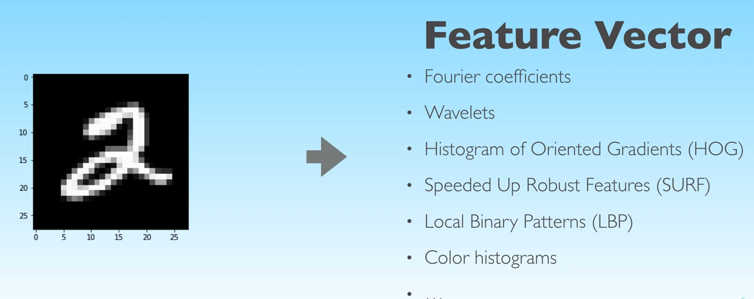
Feature Vector

Slide 11
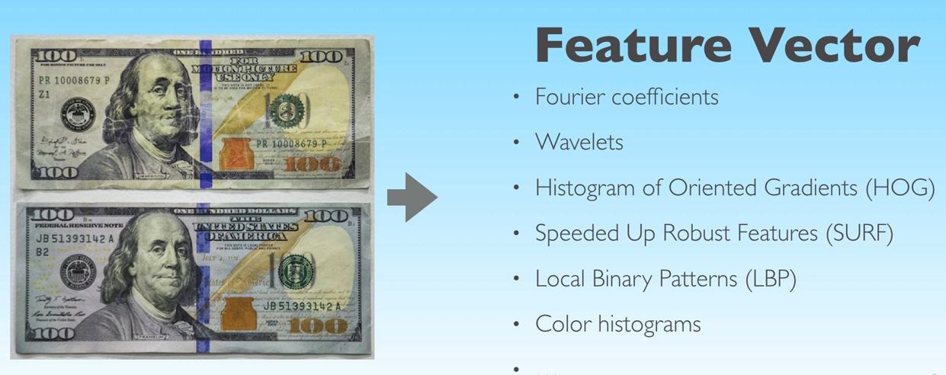
Hand Engineering Feature

Slide 12
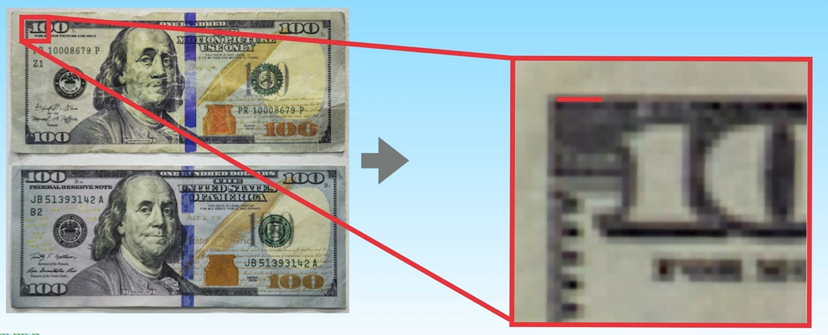
Local Patterns

Slide 13
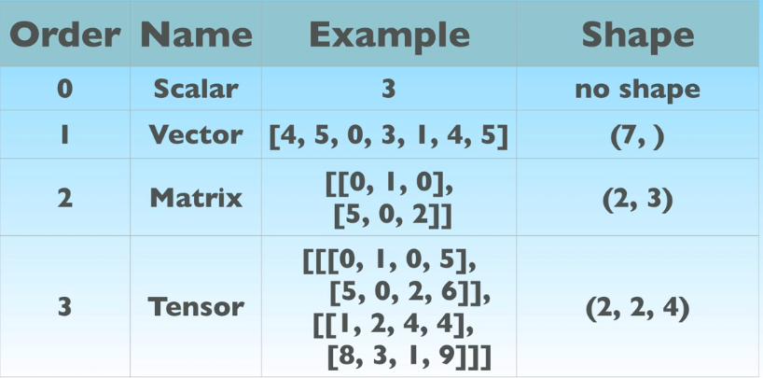
Tensors

Slide 14
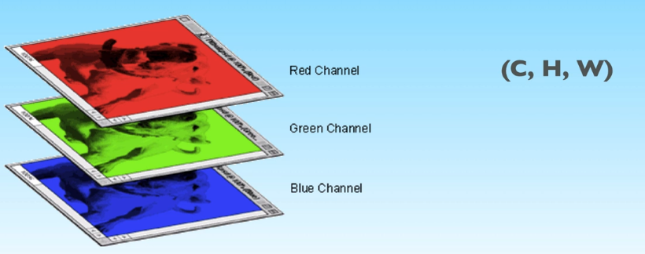
Colored Images Representation

Slide 15
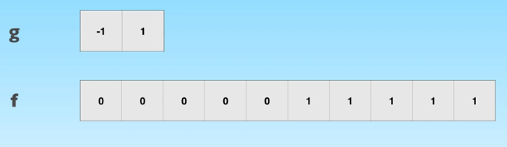
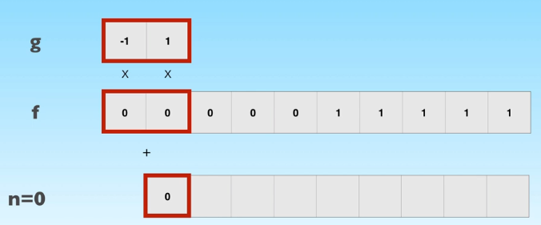
Discrete Convolution

Slide 16
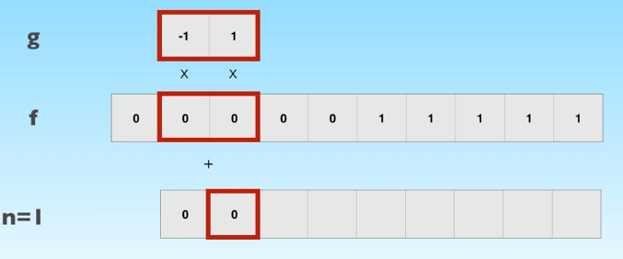
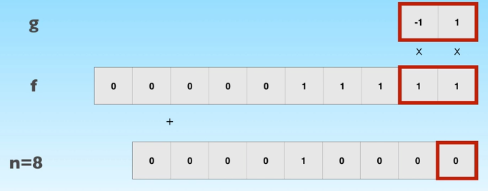
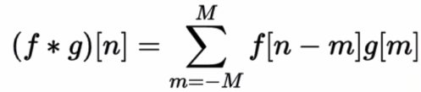
Discrete Convolution

Slide 17
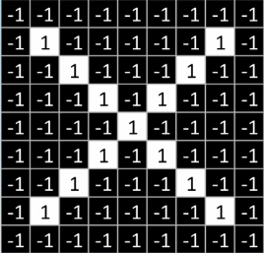
2D Convolution

Slide 18
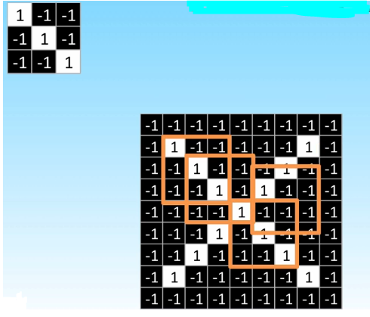
2D Convolution

Slide 19
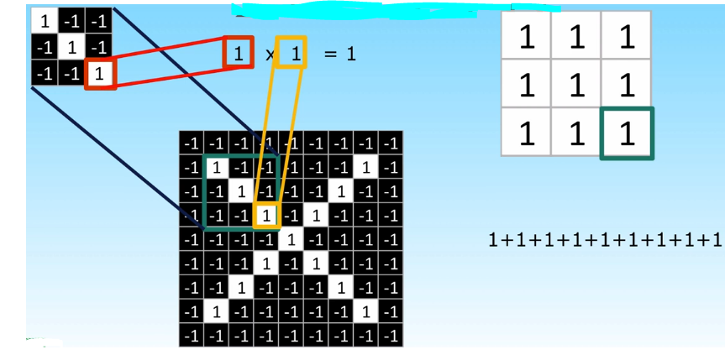
2D Convolution

Slide 20
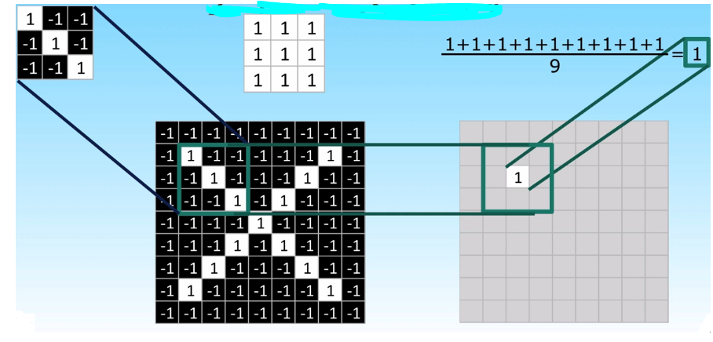
2D Convolution

Slide 21
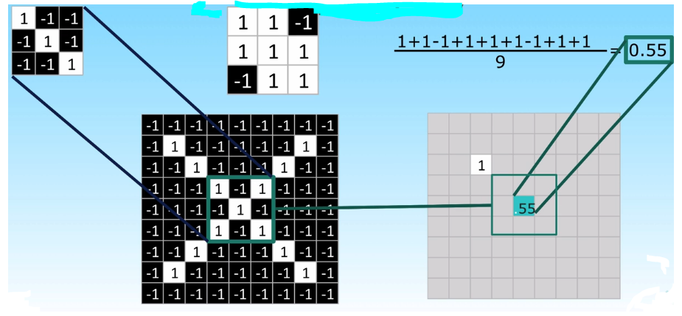
2D Convolution

Slide 22
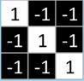
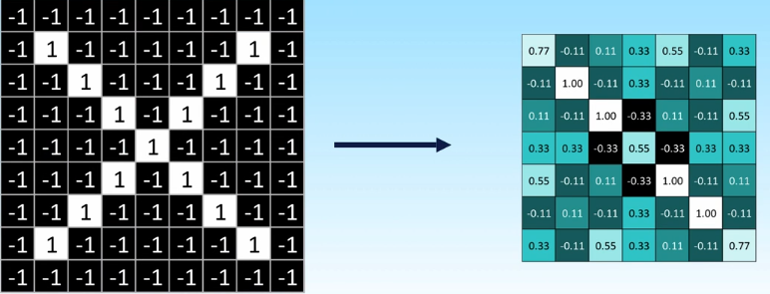
2D Convolution

Slide 23
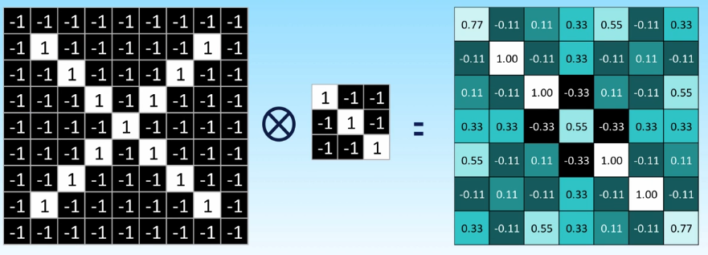
2D Convolution

Slide 24
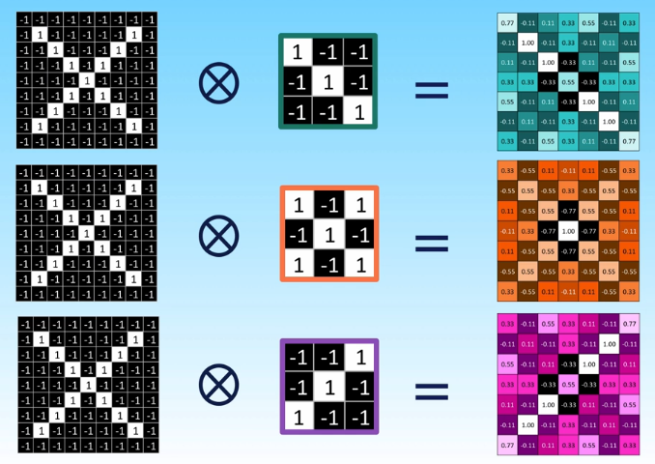
2D Convolution

Slide 25
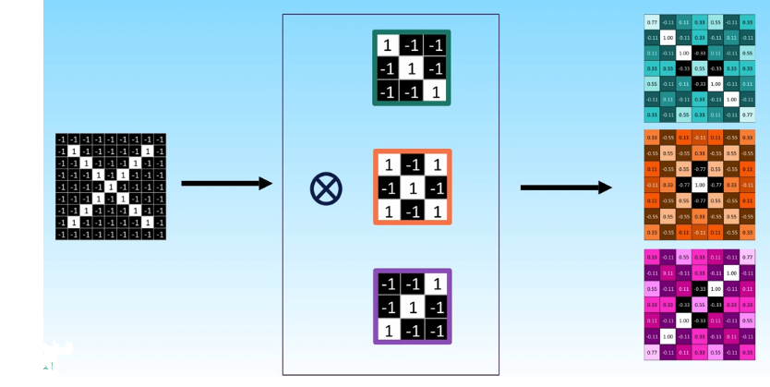
Convolutional Layer

Slide 26
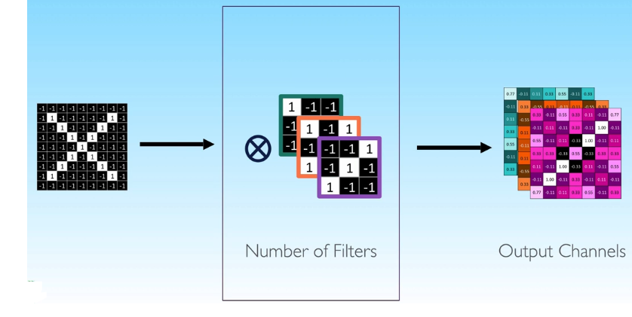

Slide 27
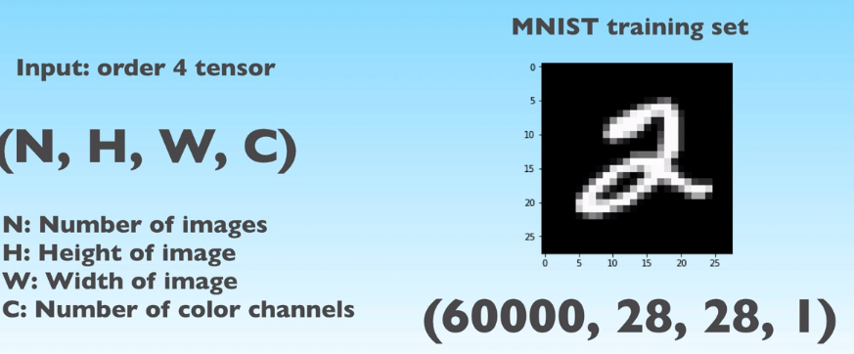
Input Tensor

Slide 28
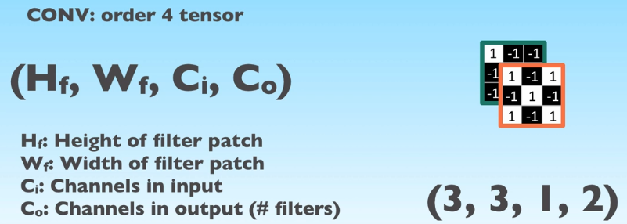
Conv Layer Tensor

Slide 29
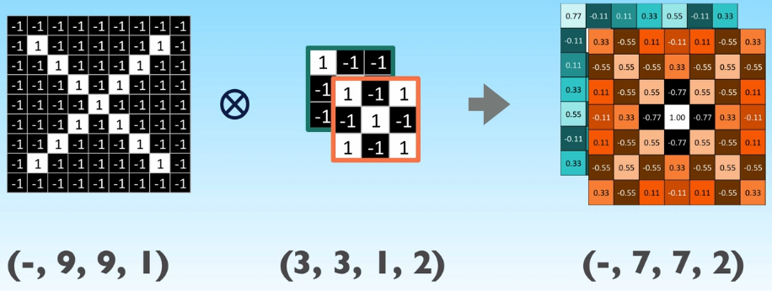
Example 1

Slide 30
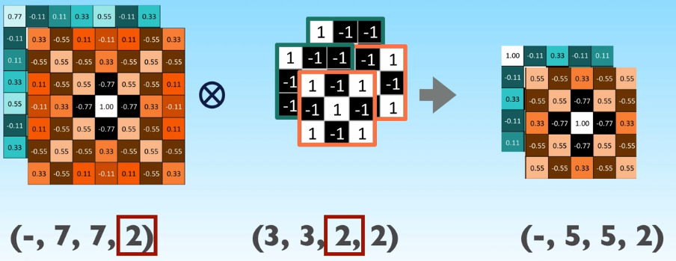
Example 1

Slide 31
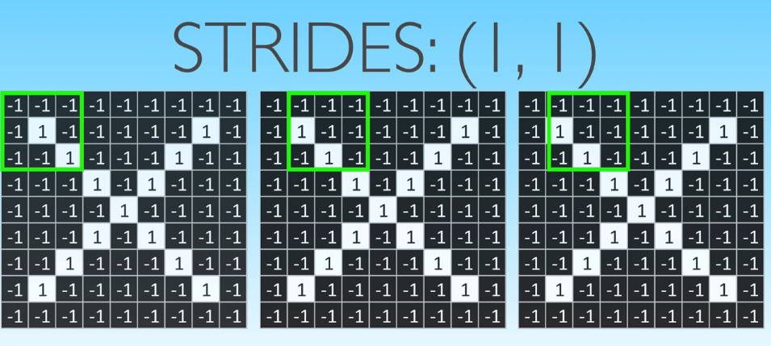

Strides

Slide 32
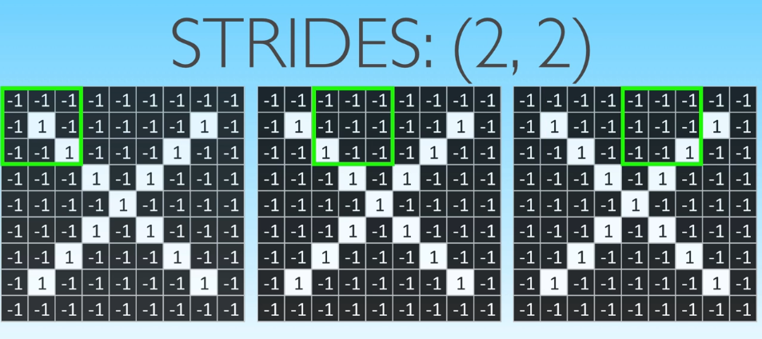

Strides

Slide 33
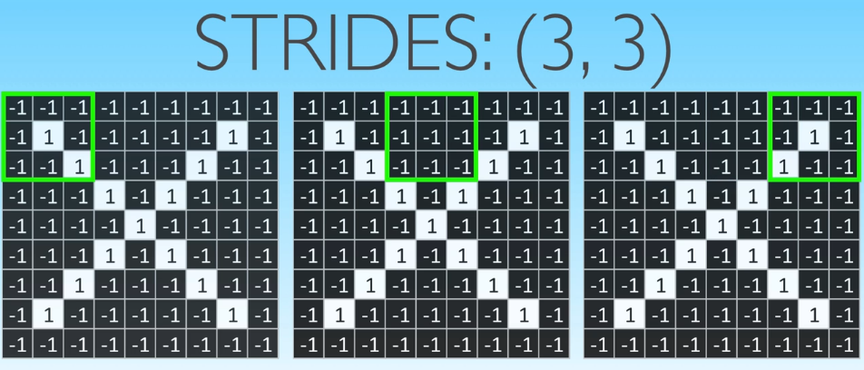

Strides

Slide 34
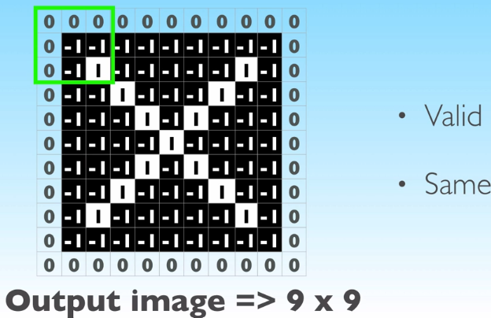
Padding Options

Slide 35
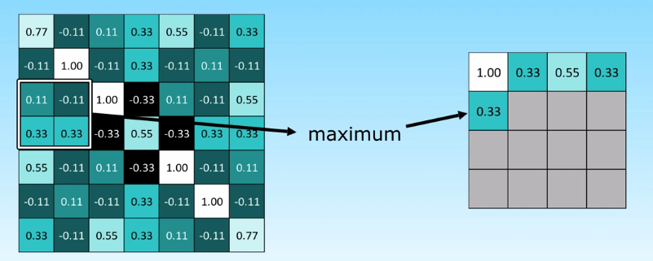
Max Pooling

Slide 36
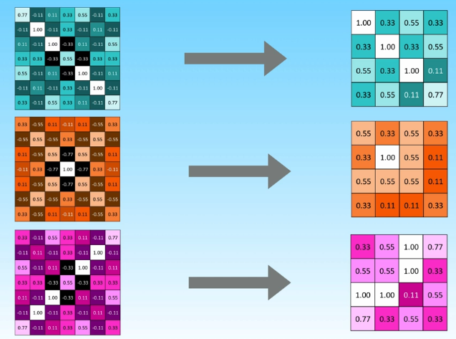
Pooling Layer

Slide 37
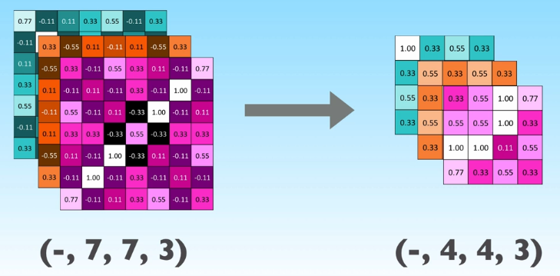
Pooling Layer

Slide 38
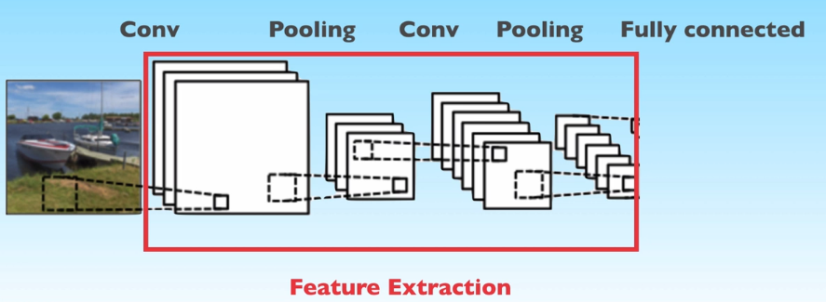
Stacking Layers in CNN

Slide 39
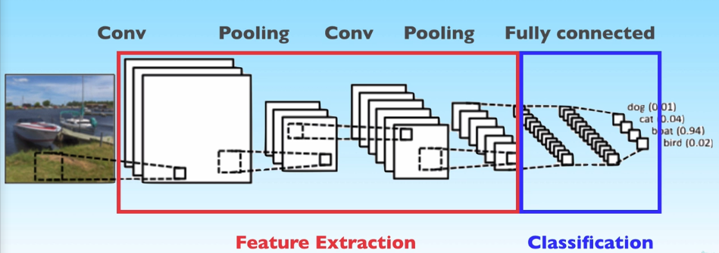

Slide 40
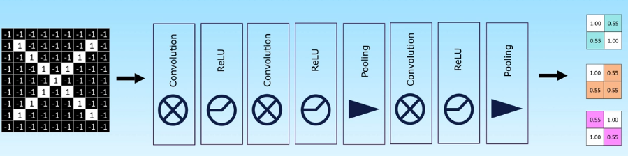
Feature Extraction

Slide 41
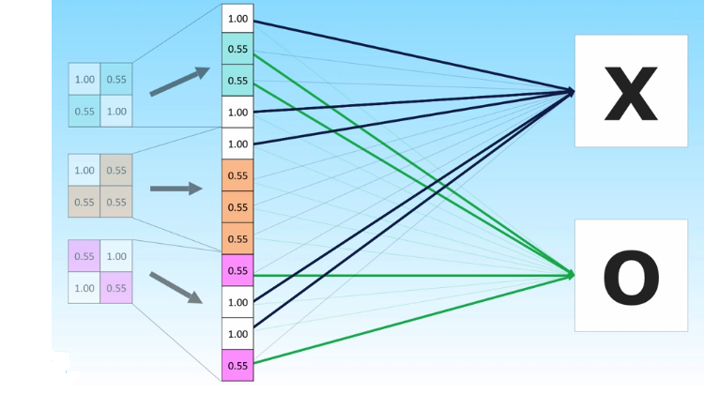

Slide 42
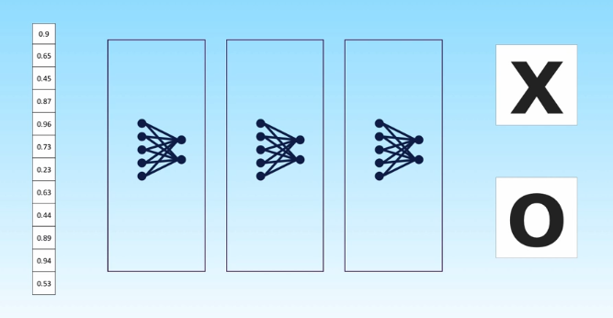
Stacked FC

Slide 43
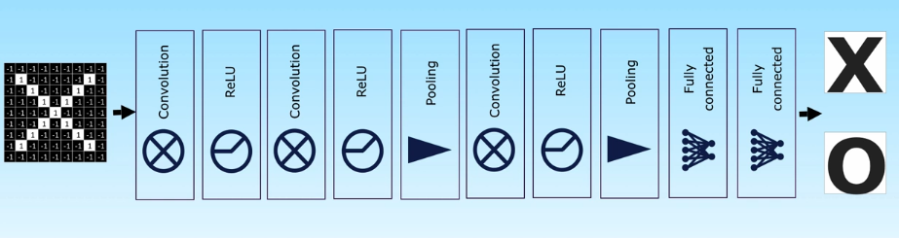
Getting it all together

Slide 44
Weights In FC
Input data: Image 10*10 => 100 Numbers
First Layer: 32 nodes => 100 weights each
=> 3200 weights!!!!

Slide 45
Weights In CNN
Input data: Image 10*10 => 100 Numbers
First Layer: 32 conv, kernel 3*3 => 9 weights each
=> 32*9 = 288 weights!!!

Slide 46
Advantages of CNN
Weights are shared by Pixels
Traded parameters with computation
Number of weights in CNNs < Number of weights in FC

Slide 47
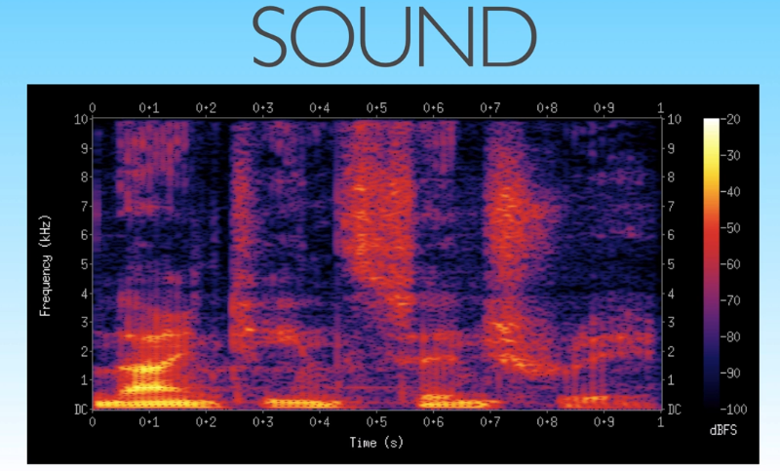
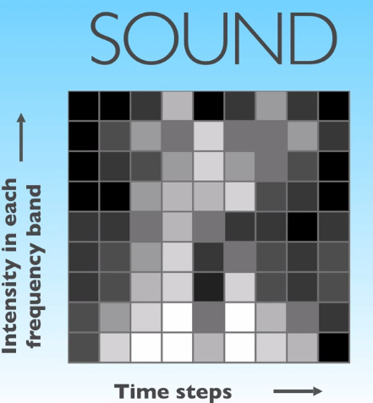
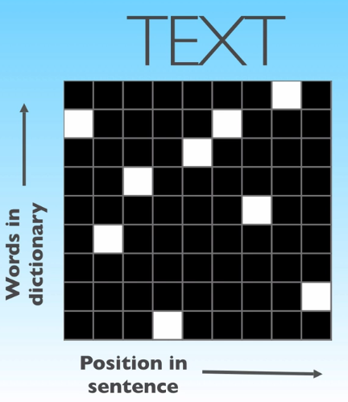
Beyond Images

Slide 48

Biggest Limitation of CNN
ConvNets capture only local “spatial” patterns in data

Slide 49
Exercise 1
You’ve been hired by a shipping company to overhaul the way they route mail , parcels and packages. They want to build an image recognition system capable of recognizing the digits in the zip-code on a package, so that it can be automatically routed to the current location. You are tasked to build the digit recognition system. Luckily, you can rely on the MNIST dataset for the initial training model!
Build a deep convolutional neural network with at least two convolutional and two pooling layers before the fully connected layer.
Start from the network we have just built
Insert a Conv2D layer after the first MaxPool2D, give it 64 filters.
Insert a MaxPool2D After that one
Insert an Activation layer
Retrain the model
Does performance improve?
How many parameters does this new model have?
How long did this model take to train?

Slide 50
Exercise two
Pleased with your performance with the digits recognition task, your boss decides to challenge you with a harder task. Their online branch allows people to upload images to a website that generates and prints a postcard that us shipped to destination. Your boss would like to know what images people are uploading on the site in order to provide targeted advertising on the same page, so he asks you to build an image recognition system capable of recognizing a few objects. Luckily for you, there’s a dataset ready made with a collection of labeled images. This is the Cifar 10 dataset, a very famous dataset that contains images for 10 different categories:
Airplane
Automobile
Bird
Cat
Deer
Dog
Frog
Horse
Ship
truck

Slide 51
Exercise 2
In this exercise we will reach the limit of what you can achieve on your laptop and get ready for the next session on cloud GPUs.
Here’s what you have to do:
Load the cifar 10 dataset using keras.datasets.cifar10.load_data()
Display a few images, see how hard/easy it is for you to recognize an object with such low resolution
Check the shape of X_train, does it need reshape?
Check the shape of X_train, does it need rescaling?
Check the shape of y_train, does it need reshape?
Build the model with the following architecture, and choose the parameters and activation functions for each of the layers:
conv2d
Conv2d
Maxpool
Conv2d
Conv2d
Maxpool
Flatten
Dense
output
Compile the model and check the number of parameters.
Attempt to train the model with the optimizer of your choice. How fast does training proceed?
If training is too slow(as expected) stop the execution and move on the the next session!

